Slide 1
Getting set up for SQL
Module overview: SQL

Slide 2

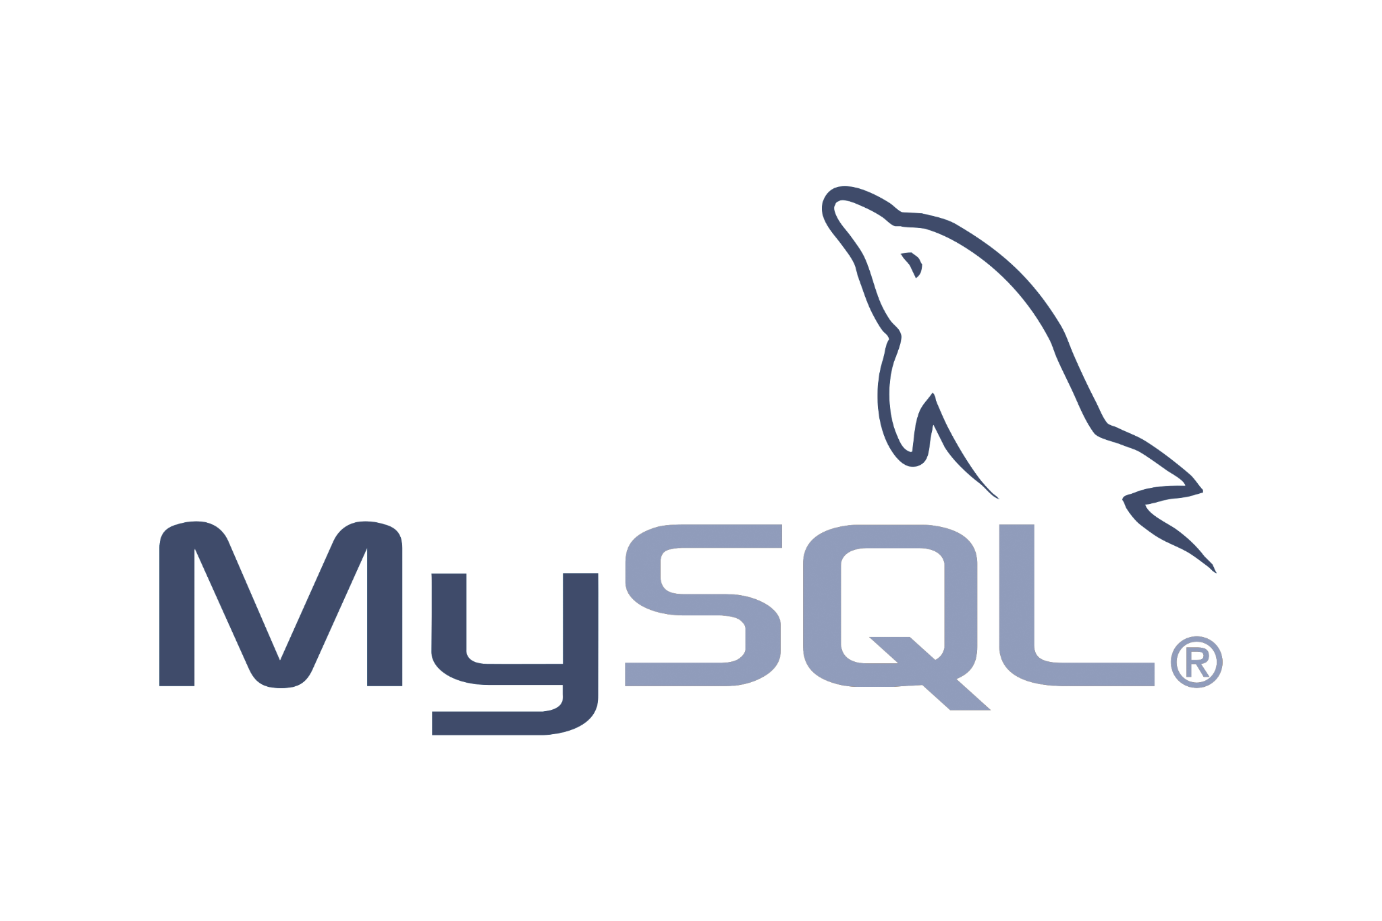

Overview
Module overview: SQL
In this module, we’ll be using:
In the next lesson, Database Concepts, we’ll go through the steps of downloading, installing, and launching MySQL Workbench and MySQL Community Server on Windows and Mac.
The various CSVs, SQL files, and queries that we'll need to create and transform our database are provided with this document. However, they can also be downloaded from the walk-throughs at the point we will need them.
MySQL Workbench
Throughout the module, we will need to use the provided CSVs, SQL files, and queries to create or recreate our database. We will look at how we use these files and queries.

Slide 3


Overview
Module overview: SQL
In this module, we’ll also be using:
In the SQL in production lesson, we’ll introduce Jupyter Notebooks and go through the steps of downloading, installing, and launching Anaconda and Jupyter Notebooks on Windows and Mac.
Included in the lessons beyond this point are [walk-throughs] in which queries are run in MySQL Workbench, as well as the accompanying [notebooks] in which we can execute the same queries in Jupyter Notebooks.
Throughout the module, we will be able to interact with and manipulate our database the same way using either MySQL Workbench or Jupyter Notebooks.

Slide 4




Completing the practical learning activities
Module overview: SQL
The [walk-through] learning activities will teach us how to query and transform our database.
We’ll need to use the same database throughout this module and only recreate the dataset when prompted.
The SQL module was designed to take us through various transformations of a single database.
In order for our queries to work, we’ll need to follow along and complete all of the walk-through activities in either MySQL Workbench or Jupyter Notebooks.
If we do not follow these instructions, many of our queries may not seem to work.

Slide 5
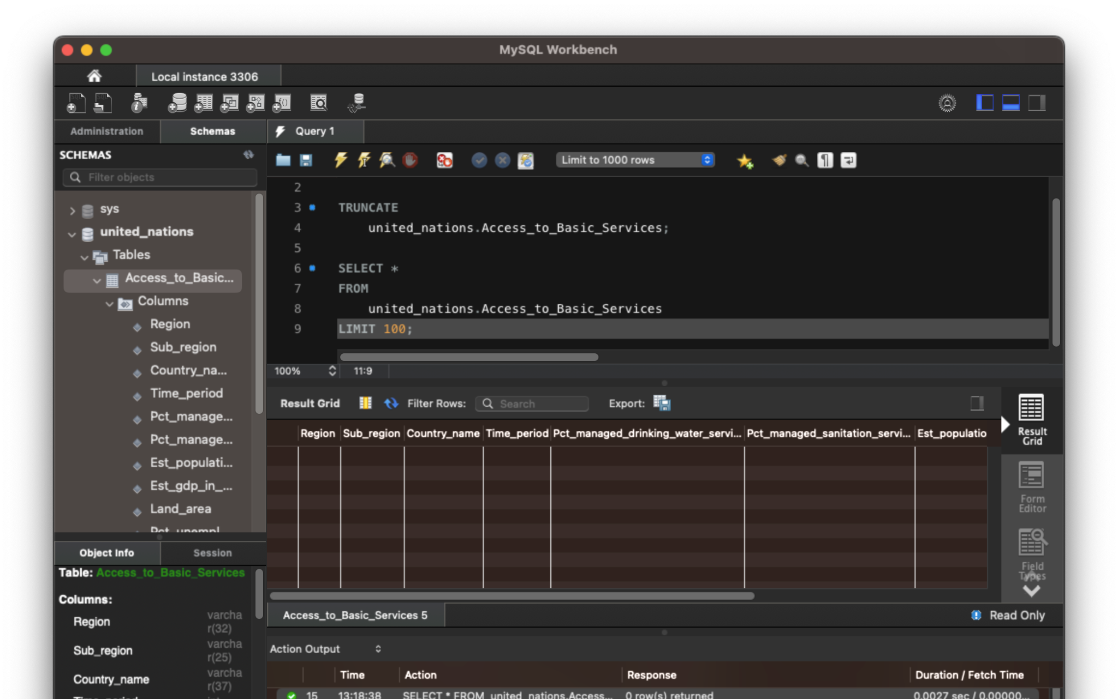
The effect of database transformations
Module overview: SQL
For example, we will learn how to remove all data from a table in SQL.
Once we've removed the data from the table, any query thereafter will return an empty table. In these cases, we'll be prompted with the necessary steps to recreate the database. It's crucial to follow these instructions closely so that future queries work.

Slide 6
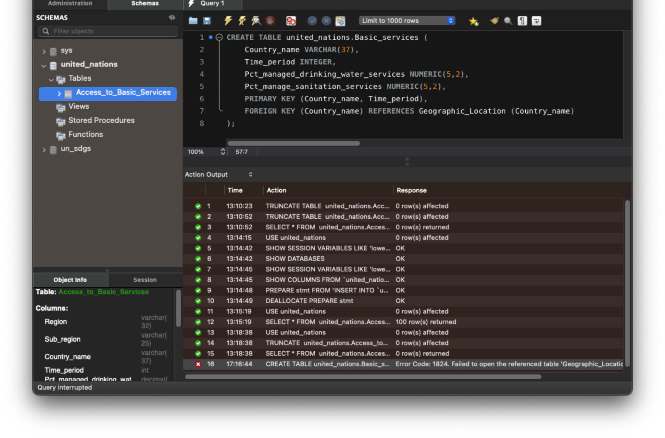
The effect of database transformations
Module overview: SQL
For example, we want to divide a larger dataset into smaller tables and link them using relationships.
The walk-throughs often build on one another, so if we don't complete them in order, we may end up in a situation like this: We created the Geographic_location table in a previous walk-through, and therefore, if we skipped it, we would get an error.

Slide 7
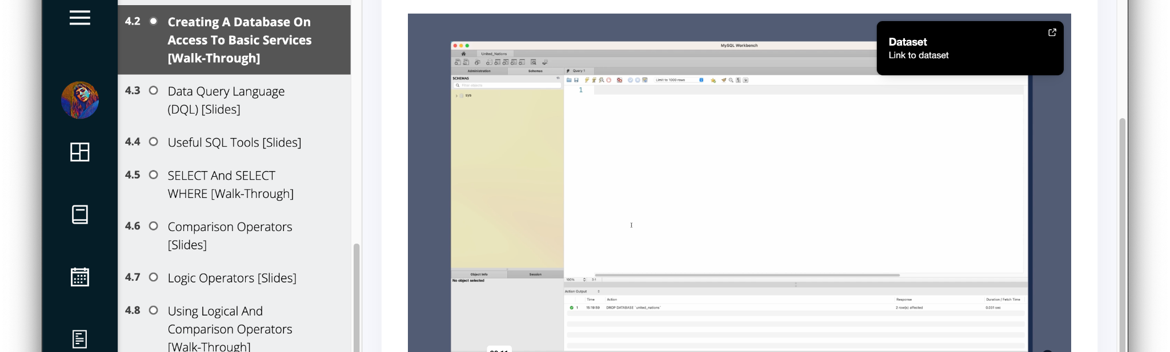

When and how to download a new dataset
Module overview: SQL
As we transform our database, we will need a CSV or new SQL file to “reset” our database to a usable format. We can find these files by clicking on the popup in the walk-through video.
Only some walk-through videos will include a dataset or file download since we will need to persist some of the changes to the database for the learning activities that follow.

Slide 8

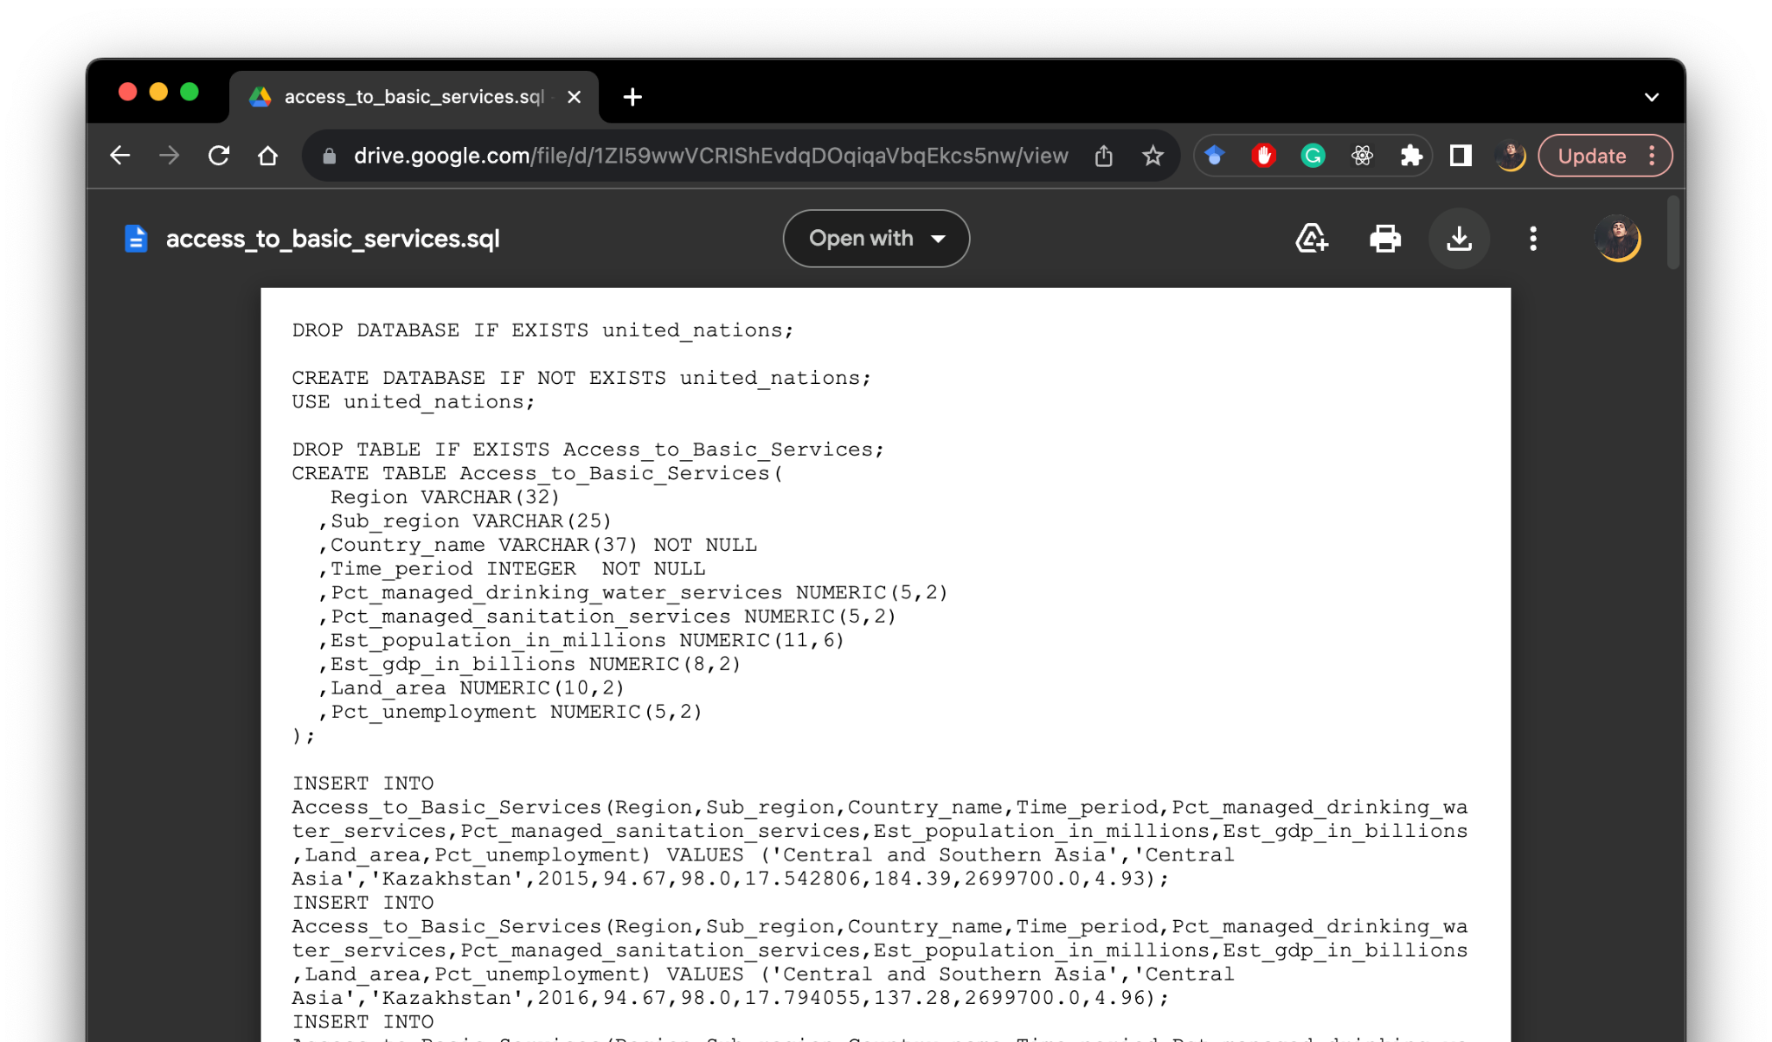
Download CSVs and SQL files
Module overview: SQL
Clicking on the Dataset popup on a walk-through will open the file in a new tab.
We can click on the download button, which will save the file to our local machine, very often to a Downloads folder.

Slide 9
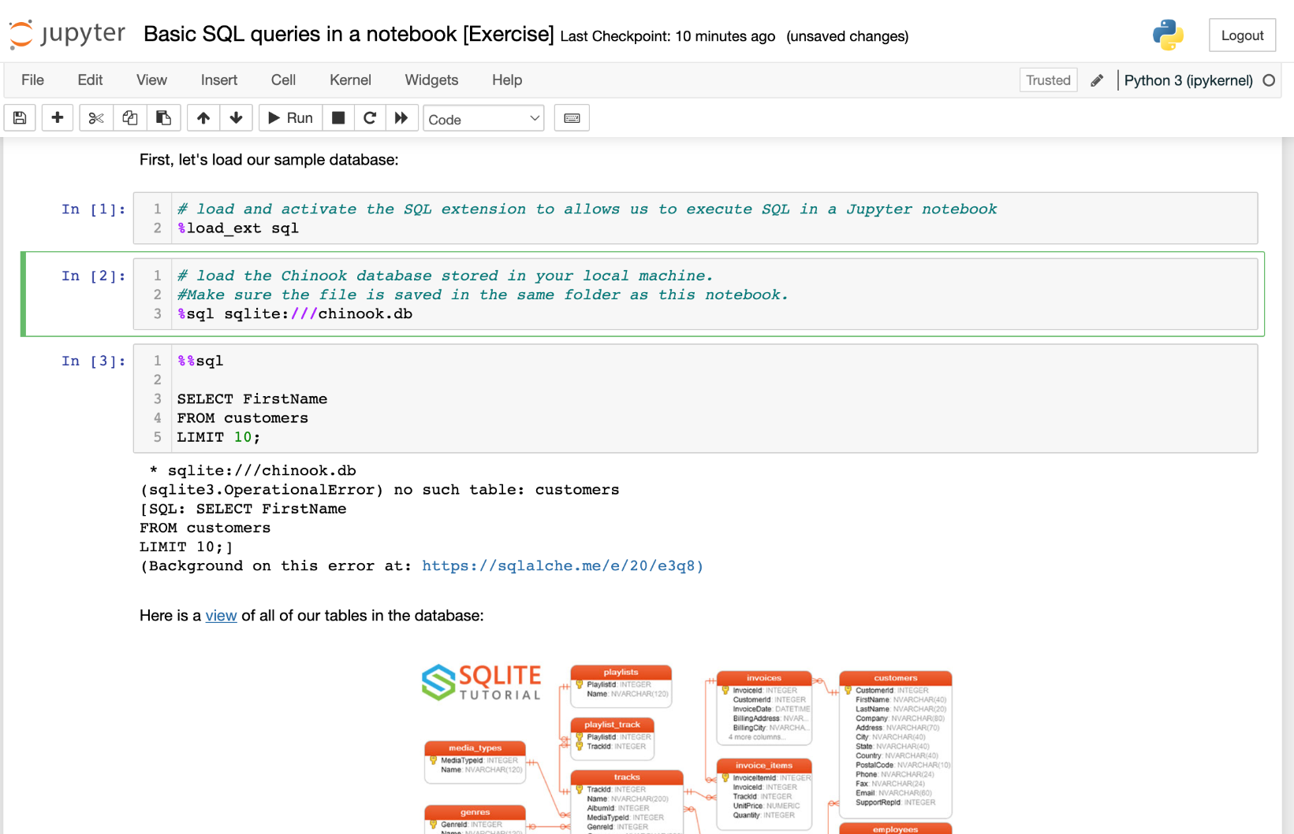
Using notebook files and dependencies
Module overview: SQL
We will receive database files that we need to query in a notebook.
The notebook environment will look for the database file in the current folder. If the file is not in the same folder as the notebook, the system won't be able to locate it, and we will get a "no such table" or similar error message. We need to make sure we have all the notebook dependencies saved in the same folder as the notebook.

Slide 10
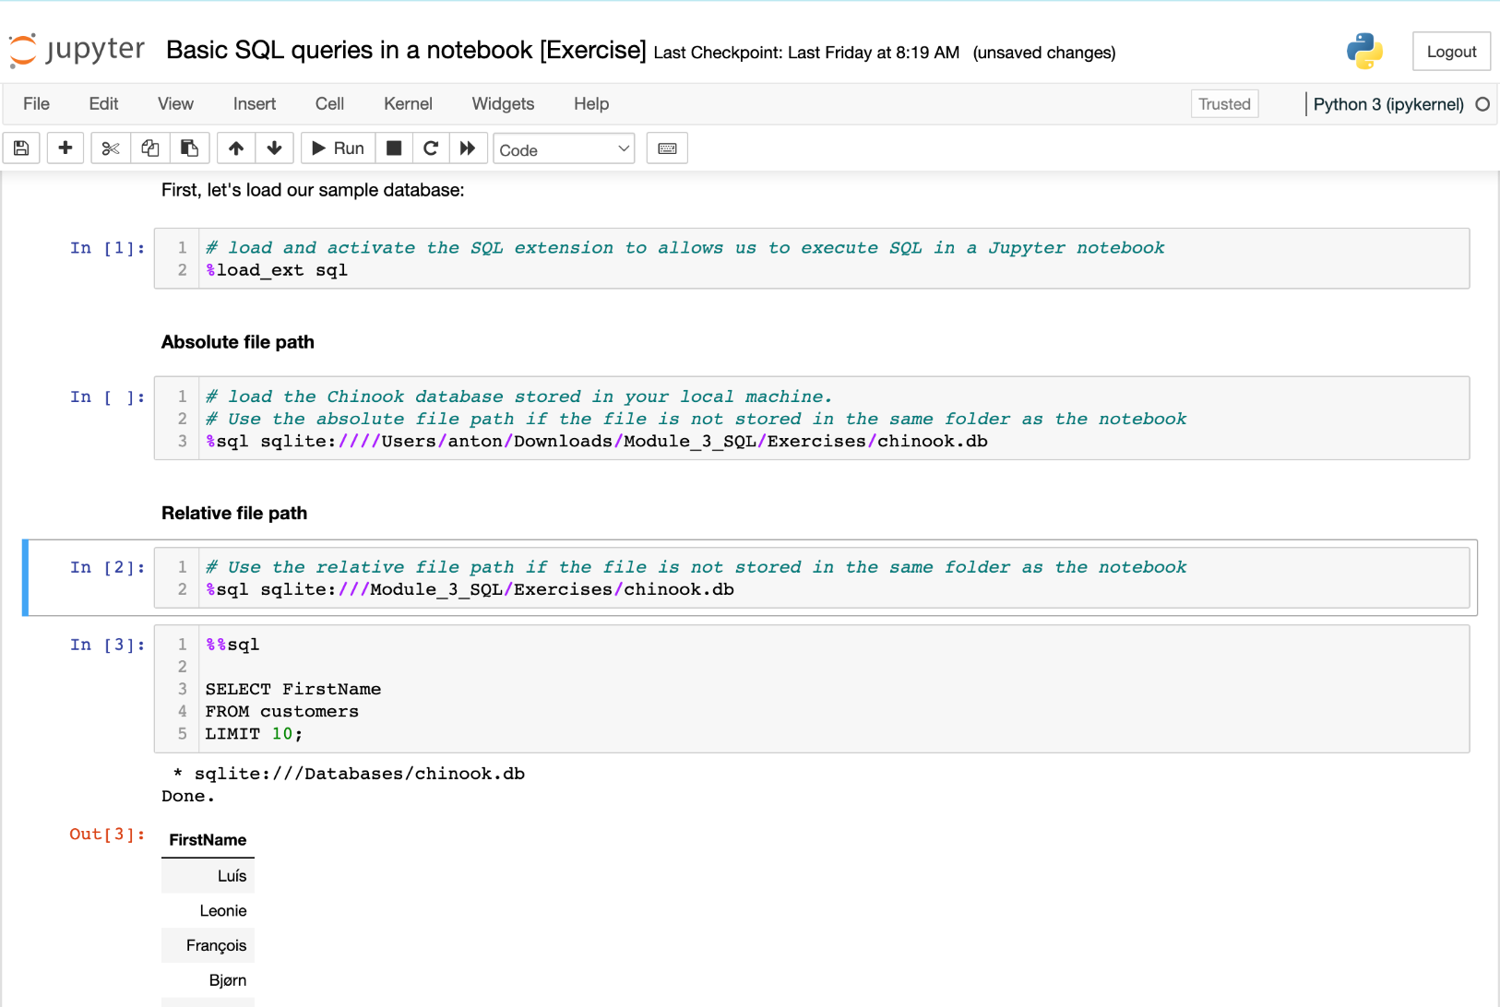
Using notebook files and dependencies
Module overview: SQL
It is possible to specify the correct file path in our code if the file is not saved in the same folder.
Should the database be saved in a different folder, we will need to use the absolute or relative file path to locate the folder.
We use three slashes sqlite:/// in order to use a relative path.
We use four slashes sqlite://// in order to use an absolute path.

